Slide 1
Sentiment Analysis on UP-related Communities in Facebook and Twitter Using Hadoop
Rahmat Peter I. Dabalos, LailanIe R. Danila, Joseph Anthony C. Hermocilla

Slide 2
abstract
The rapid increase of the data present in the world can be attributed to the advent of social media, wherein, discourses almost about everything ranging from personal to societal issues are being tackled. There comes the problem of handling and making sense of Big Data. To be able to solve this problem, huge amounts of processing power must be utilized, this is possible through the use of the Cloud Computing as the platform for such studies. Sentiment Analysis is the study of the sentiments, opinions, and moods expressed in written language. It is inside of the wide spectrum of Natural Language Processing, the field in which creation of systems and tools are done to recognize patterns and relationships within written text as it is cumbersome to do it manually. With that, analysis, classifications, and predictions of the meanings in written language is possible with little human involvement on huge amounts of data present in social media.

Slide 3
Background
Today, the world is data rich because of the rise of technology. It is hard to make sense of this data since it is massive.
Cloud Computing is the utilization of many computers to have more computing power, it is the best model in handling Big Data.
Apache Hadoop is a framework that provides tools for facing Big Data Problems. Hadoop Distributed File System, and MapReduce Function will be used for this project.
Sentiment analysis is in the area of study in Natural Language Processing that deals with classifying if a given text implies positive, or negative meaning.

Slide 4
Statement of the Problem
Nowadays, social media sites such as Facebook and Twitter are the venue for people to blurt out their opinions, sentiments, and concern about anything under the sun. Usually This is in the form of tweets and posts. What the researcher intends to do is to get a consensus on the moods and opinions of the UP students by getting their posts and tweets and processing it through sentiment analysis through the use of Hadoop.

Slide 5
Objectives
The main objectives of this study are the following:
To utilize social media, specifically Facebook and Twitter, as a source of data for sentiment analysis.
To provide a tool which will make the processing of data in social media effectively and efficiently through the use of Hadoop, and
To examine, analyze, and report the sentiments of University of the Philippines students to issues that they face in the university or in the country.

Slide 6
Scopes and Limitations
Posts and Tweets will only be collected from UP-related communities in Facebook and through the use of ‘#’ in Twitter. But the result will be available to everyone.
Limited only to using the HDFS and MapReduce from Apache Hadoop Framework.

Slide 7
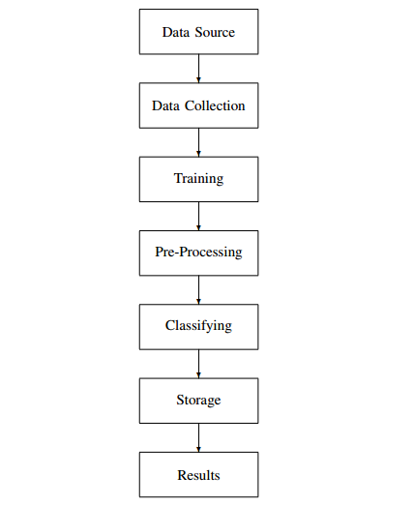
Theoretical Framework

Slide 8
Data SourceS
Data that will be collected from:
Facebook:
1) Narinig ko sa UP Group
The Elbi Files
The Diliman Files
2) Twitter: For Twitter, the ’#’ will be used in order to search for tweets that are related to the topic of interest.
UPsaHalalan UP Halalan UPLB PoeVisitsUPLB AyokongMagmahal Duterte UPLB DuterteVisits UPLB FacultyCenter MDSUPLB MiriamUtakAtPuso Stephen Villena UPFight UPLBWalkout AbuSayyaf BigasHindiBala Pilipinas2016 PilipinasDebates2016 Presidentiabledebates PhilippinesElections2016 Philippines Elections Philippines Elections 2016 NoToMarcos Halalan2016 philippinesElections PHVote

Slide 9
Data Collection:
In order to collect the data from the given sources the following tools are used:
Rfacebook- A package in R that implements Graph API was used to gather data from public pages and groups in Facebook
twitteR- A package in R that was used to gather data from twitter through searching for keywords
Apache Flume- Apache Flume is a tool that ingests data for collecting, aggregating and transporting large amounts of streaming data from various servers, in my case from Twitter, to my HDFS
Apache Hive - In order to make sense of the data gathered by flume, Hive was used as it supports reading, writing, and managing data stored in a distributed storage such as HDFS through SQL.

Slide 10
Training
Before processing the tweets, each word in the dictionary that has subjective meaning are classified as positive, negative. A sample data set from this source: http://thinknook.com/twitter-sentiment-analysis-training-corpus-dataset-2012-09-22/ was used for better results. It was in English, So, to add Filipino Words, the whole file was translated through google.translate.com.
And for the dataset for the Naive Bayes' classifier, tweets and posts that were close to the subject of the data being tested were picked out and verified by 3 other people in order to have an agreement and so that there would be no bias.

Slide 11
Pre-processing
Because the data that were gathered were surely composed of many unnecessary data, at this stage, the dataset was filtered so that, only the relevant data were used in the next processes. A script was implemented to remove irrelevant columns and trailing spaces, so that the data were clean. The data extracted on each post or tweet are: id, username, and text.

Slide 12
B. Non-Functional Requirements
Performance Requirements
Safety Requirements
Scalability Requirements

Slide 13
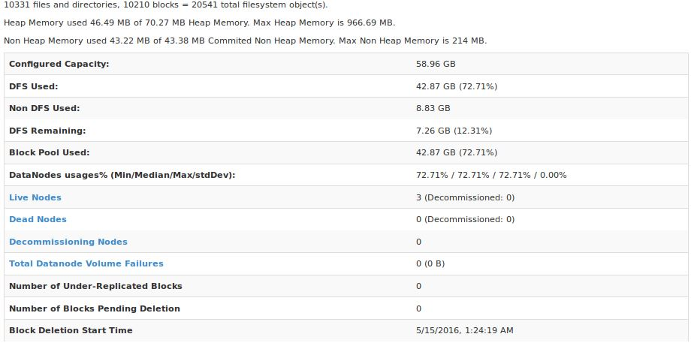
RESULTS AND DISCUSSIONS

Slide 14
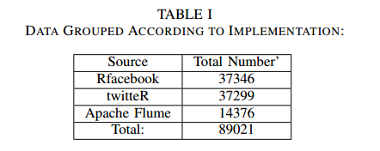
RESULTS AND DISCUSSIONS

Slide 15
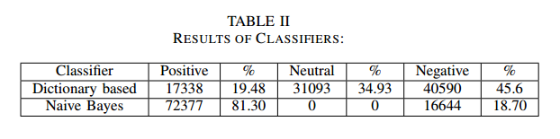
RESULTS AND DISCUSSIONS

Slide 16
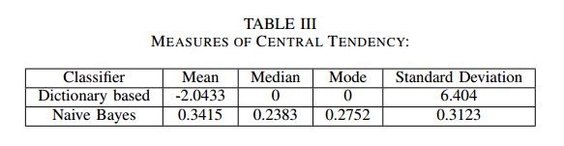
RESULTS AND DISCUSSIONS

Slide 17
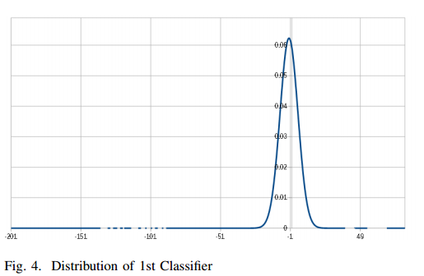
RESULTS AND DISCUSSIONS

Slide 18
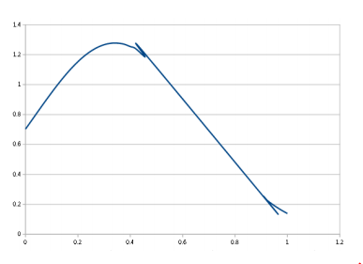
RESULTS AND DISCUSSIONS

Slide 19
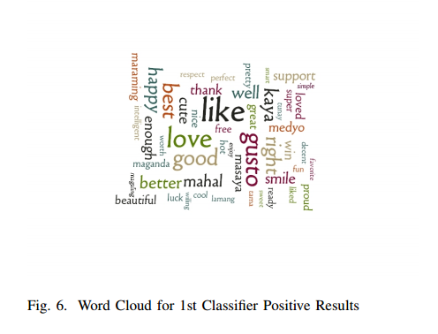
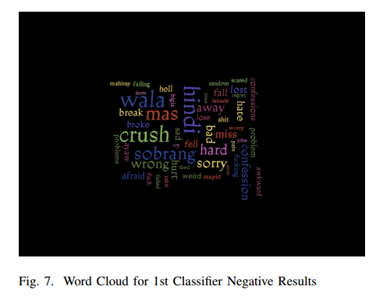
RESULTS AND DISCUSSIONS

Slide 20
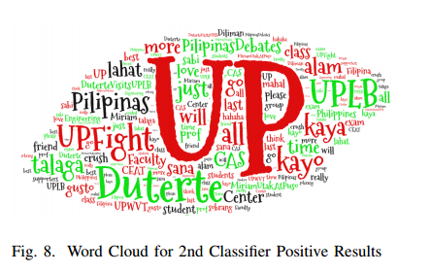
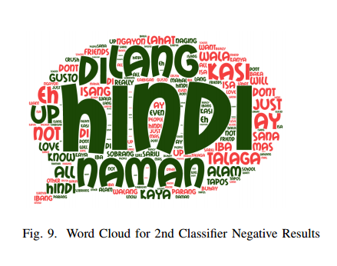

Slide 21
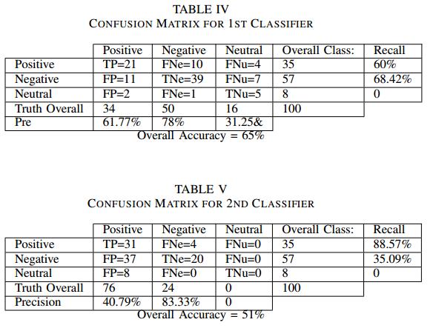

Slide 22
concLUSION AND FUTURE WORK
Sentiment Analysis is the discipline concerned with understanding and predicting the opinion, sentiment, and belief gathered from written language. Social Media which is data-rich proved to be a good source for such analysis to be conducted although compared to other sources it has many challenges. This project was able to solve the problem of shortage of resources when dealing with big data because of the use of Cloud computing as the platform and Hadoop as the distributed shortage. Efficiently configuring the properties of the cluster resulted to the effectiveness of the Map Reduce functions and the huge amount of data gathered was able to be processed quickly. With the quality of the classifiers, it is not bad because compared to professional or companies that do sentiment analysis the accuracy was only 80\% mainly because the 20\% of the deficiency is attributed to the level of complexity of sentiment analysis. Comparing the two classifiers implemented, the more accurate one is the first classifier, and based from the results of that; messages from social media about those issues mentioned above are said to be more negative than positive, but with a lot of neutral. It means that, with regards to those issues, the general public is negatively affected and that they are more likely to share their negative sentiments by venting out, cursing, and other ways to imply disapproval but there are also a lot of posts or tweets that could only be about narratives, and information dissemination thus having more neutral than the least which is positive. \par

Slide 23
CONCLUSION AND FUTURE WORK
For future works, it would be worth exploring on the topic of creating datasets that are able to recognize typographical errors and other ways on improving the way the sentiments are being analyzed. If a pattern on how a positive or negative message is discovered, the improvement of the algorithms can be obtained.

Slide 24
References
[1] L. Mearian, “Scientists calculate total data stored to date: 295+ exabytes,” Feb. 2011. [Online]. Available: http://www.computerworld.com/article/2513110/datacenter/scientists-calculate-total-data-stored-to-date–295–exabytes.html
[2] G. E. (2015) What is cloud computing? [Online].Available: http://asia.pcmag.com/networking-communications-softwareproducts/2919/feature/what-is-cloud-computing
[3] R. M. (2015, March) Map reduce definition. [Online]. Available:http://searchcloudcomputing.techtarget.com/definition/MapReduce
[4] C. Bhadane, H. Dalal, and H. Doshi, “SentimentAnalysis: Measuring Opinions,” Procedia Computer Science, vol. 45, pp. 808–814, 2015. [Online]. Available:http://linkinghub.elsevier.com/retrieve/pii/S1877050915003956
[5] “Company Info | Facebook Newsroom.” [Online]. Available:http://newsroom.fb.com/company-info/
[6] N. Sheikh, “Big Data, Hadoop, and Cloud Computing,” in ImplementingAnalytics. Elsevier, 2013, pp. 185–197. [Online].Available:http://linkinghub.elsevier.com/retrieve/pii/B9780124016965000116
[7] A. R. Leskovec, Jure and J. Ullman, “Data mining,” Cambridge:Cambride University Press, 2014. [8] I. A. T. Hashem, I. Yaqoob, N. B. Anuar, S. Mokhtar, A. Gani, and S. Ullah Khan, “The rise of big data on cloud computing: Review and open research issues,” Information Systems, vol. 47, pp. 98–115, Jan. 2015. [Online]. Available: http://linkinghub.elsevier.com/retrieve/pii/S0306437914001288 [9] E. Ch’ng, “The Value of Using Big Data Technologies in Computational Social Science,” Aug. 2014. [Online]. Available: http://arxiv.org/abs/1408.3170 [10] J. Serrano-Guerrero, J. A. Olivas, F. P. Romero, and E. Herrera-Viedma, “Sentiment analysis: A review and comparative analysis of web services,” Information Sciences, vol. 311, pp. 18–38, Aug. 2015. [Online]. Available:http://linkinghub.elsevier.com/retrieve/pii/S0020025515002054

Slide 25
references
[11] J. Martin, A. Ortigosa, and R. Carro, “SentBuk: Sentiment analysis for elearning environments,” in 2012 International Symposium on Computers in Education (SIIE), Oct. 2012, pp. 1–6. [12] “About technologies: Analyse Tweets using Flume, Hadoop and Hive.” [Online]. Available: http://www.aboutechnologies.com/2014/12/analysetweets-using-flume-hadoop-and.html [13] “Welcome to Apache Flume Apache Flume.” [Online]. Available: https://flume.apache.org/ [14] “Apache Hive TM.” [Online]. Available: https://hive.apache.org/ [15] C. Stedman, “Analytical models in big data environments often best left small.” [Online]. Available: http://searchbusinessanalytics.techtarget.com/feature/Analyticalmodels-in-big-data-environments-often-best-left-small

